Slide 1
Social network KNOWLEDGE PORTAL
Submitted to: Submitted by:
Mr. Ashish saklani Dheeraj sharma
Asst. professor Rahul semwal
BTKIT,DWARAHAT Pooja fartyal
Neeraj chauhan

Slide 2
contents
Introduction
Aim
Benefits
Key features
Flowcharts
Usecase diagram
Data flow diagram
ER diagram
Screenshots

Slide 3
INTRODUCTION
This portal is the knowledge hub.
This portal provides study material like – e-books , notes , educational videos , documents etc. to the users (student and faculty) that are interested to get knowledge about user’s fields .
Activities of student.
Activities of faculties.
Query box.

Slide 4
AIM
The aim of this project is the information flow over admin, faculty and students.
Improve skills of user .
The purpose of the portal is to provide the students a friendly set of web pages that are easy to navigate and at the same time provides sufficient depth and information about his or her fields.

Slide 5
benefits
Students can communicate with faculties and each other.
Timely and up to date information that encourages readers to return to the site
Call to action, and plans for students to follow to prepare for a competition career
Downloads
Syllabus of each semester for students of the college
Assignments and notes provided by college faculties
Videos lectures etc.

Slide 6
KEY FEATURES
SIGN UP PHASE
SIGN IN PHASE
UPLOADING PHASE
FLOW CHART
DATA FLOW DIAGRAM
ER DIAGRAM

Slide 7
Flow chart for sign up
yes
no
no
yes no
yes
Sign up page
Fill the information
By user
Check null
values
Please enter all entries
Member is student?
Profession and email id
Enter university rollno. Email id
Null value
Submit then check validations
Alert box
valid
Send confirmation id on email
END

Slide 8
SIGN IN FLOW CHART
no
yes
Sign in page
Enter user name,password
Validation check after sign in
valid
ERROR
Load bucket page
END

Slide 9
USE CASE DIAGRAM
Sign Up
Sign in
STUDENT
FACULTY
Home Page
Download and uploading
Submit
Feedback

Slide 10
DATA FLOW DIAGRAM
Faculty information
upload download data
student information
Upload data
Download data
DATABASE
Faculty
student
System process

Slide 11
ER DIAGRAM
Entity relationship
U _ id
____
upload
link
User
D _ id
____
______
User name
email
Pass
word
documents
title
Upload video
like
U _ id
link
title
videos
V – id
__
U _id
like

Slide 12
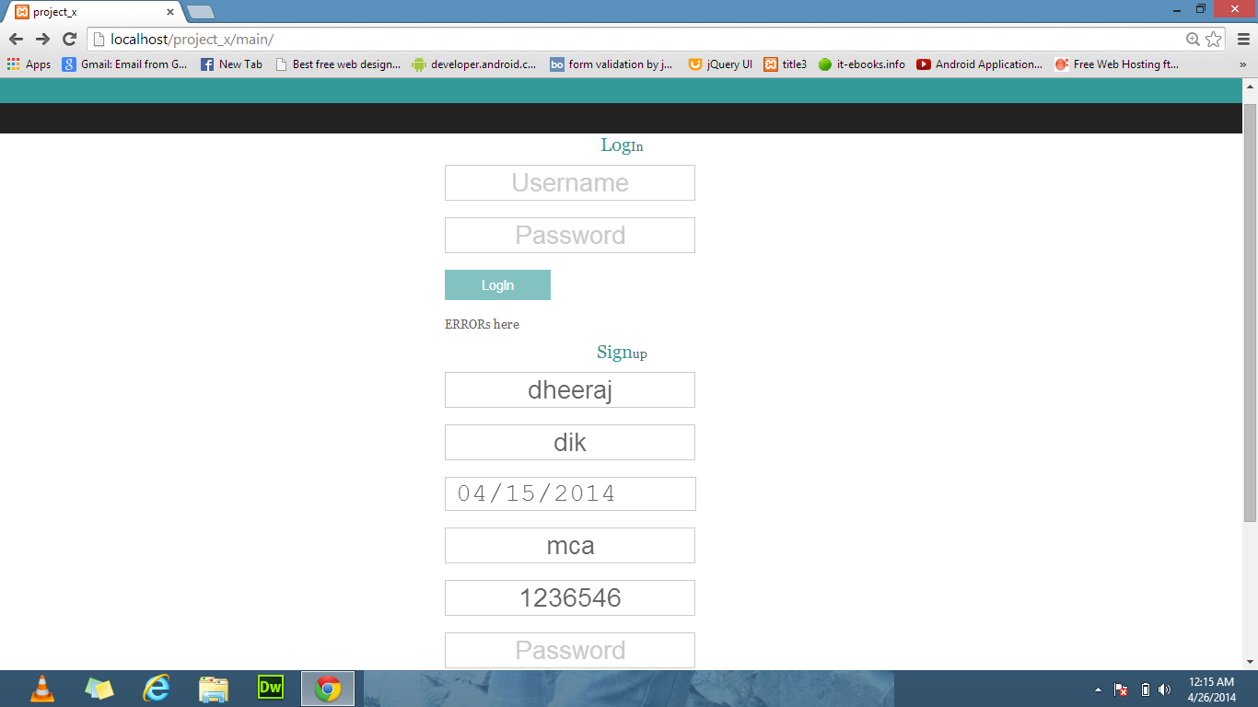
Screen shots

Slide 13
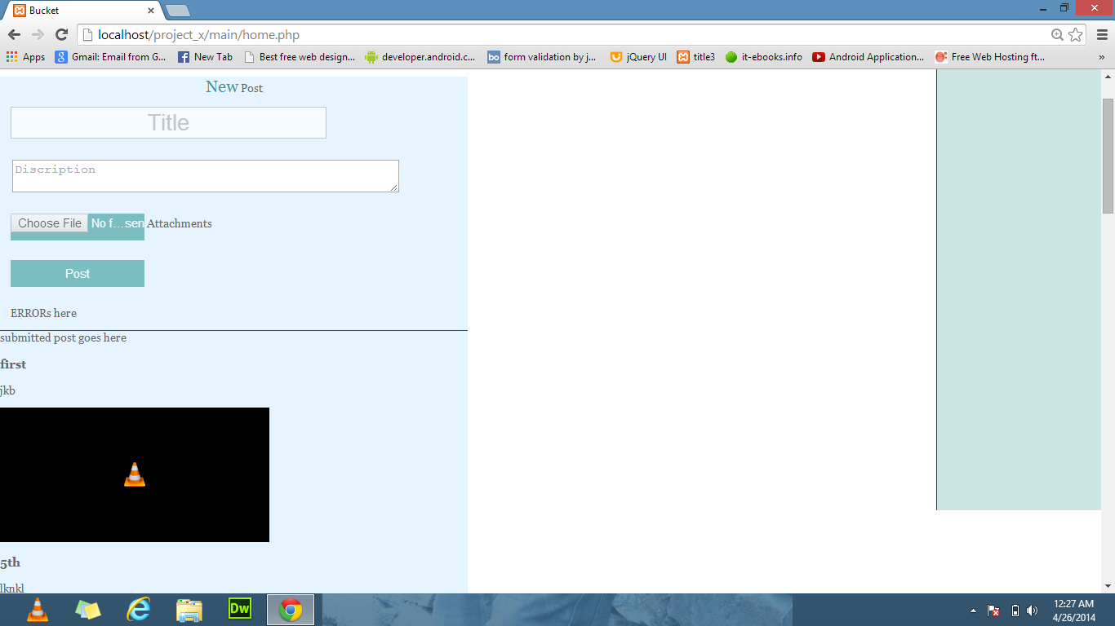

Slide 14
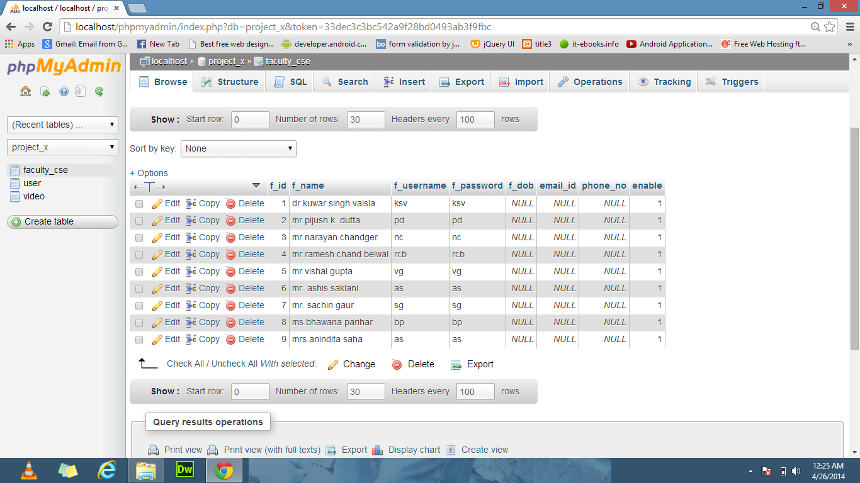

Slide 15
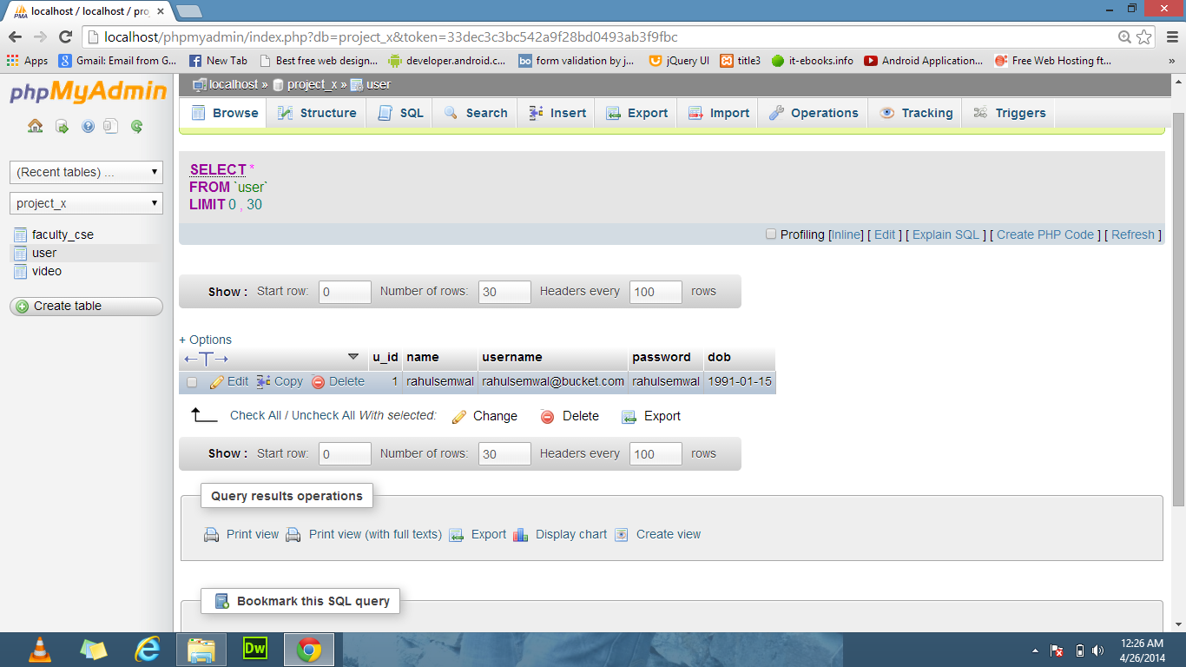

Slide 16
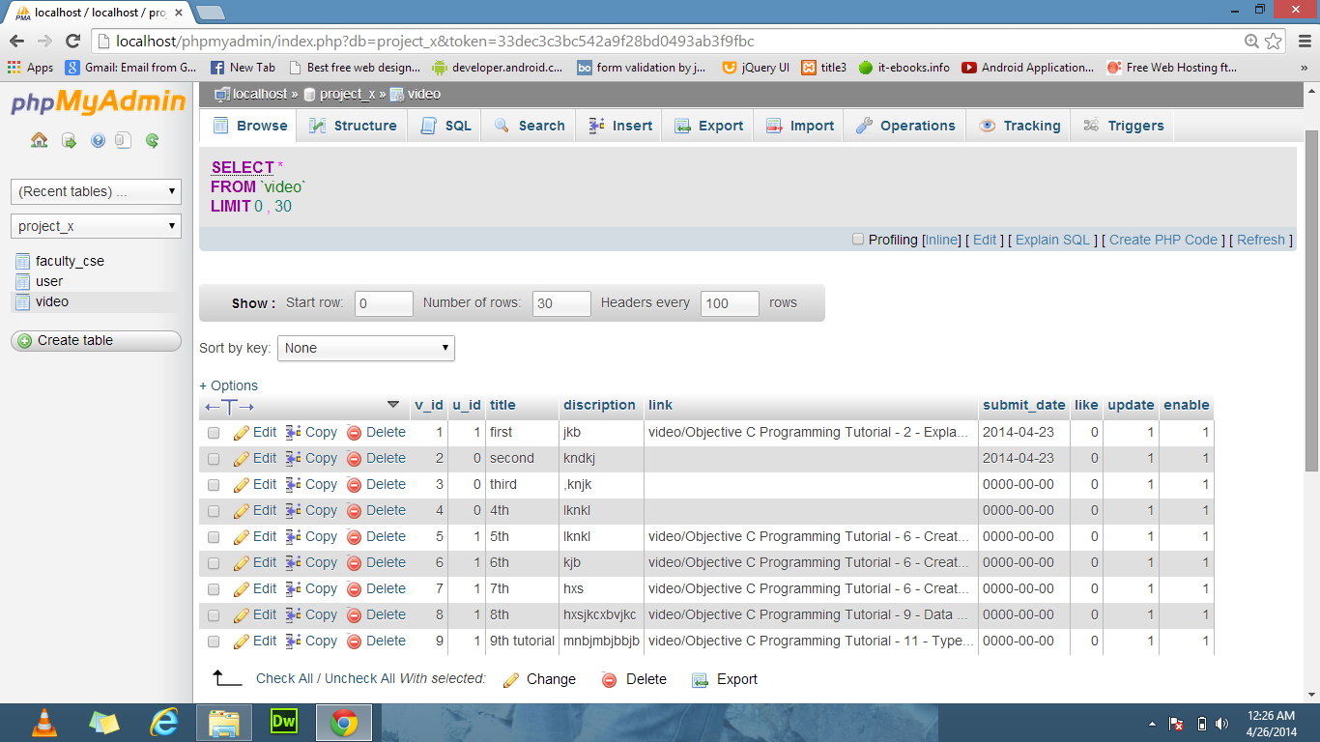

Slide 17
THANK YOU…

